Slide 1
ArrayList
Simeon Angelov
Notes:
Hello everyone in the course on:
With me:

Slide 2
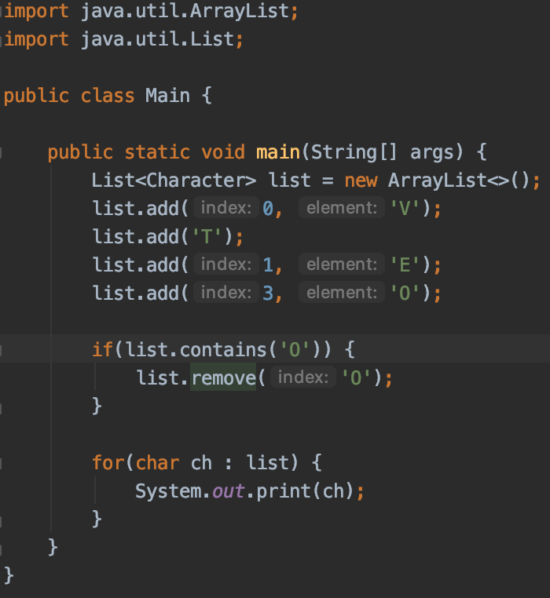
Q1. Having in mind the code bellow what is the result ?
a) VTE
b) VET
c) RuntimeException
d) VETO e) Compilation error f) VTEO
c) runtime error - as at line 17 list.remove(‘0’) removes the instance from index 78 - the int of character ‘0’ -
A char is promoted to an int, which takes precedence over autoboxing, so remove(int) is called instead
of remove(Object) you may have intuitively expect.

Slide 3
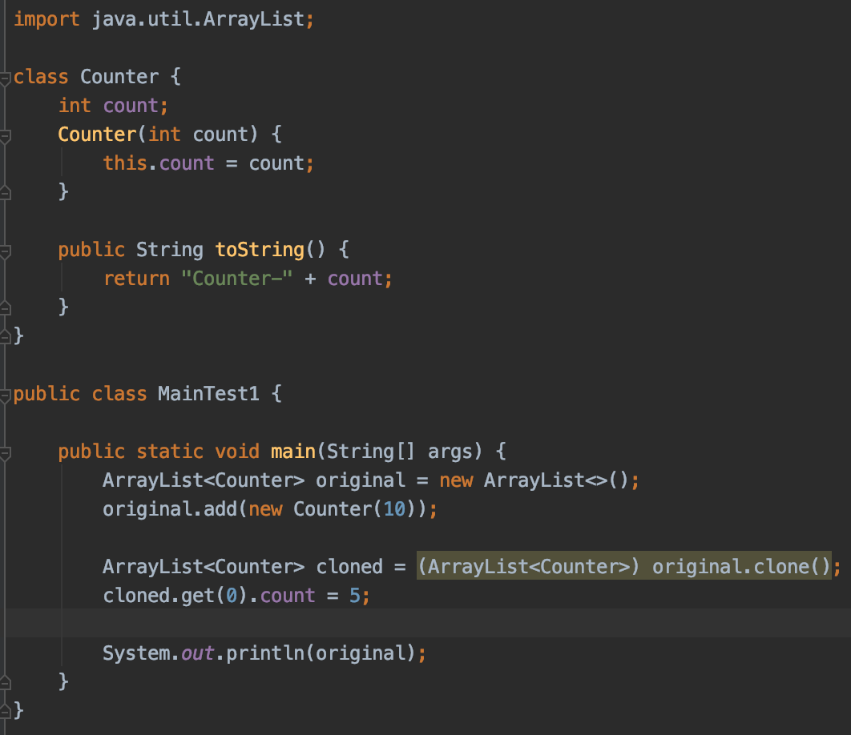
Q2. Having the source code what is the result ?
a) Counter-10
b) Counter-5
c) Compilation error
d) Runtime exception
b) Counter-5 - clone clones the elements by reference , so objects are one and same in the memory

Slide 4
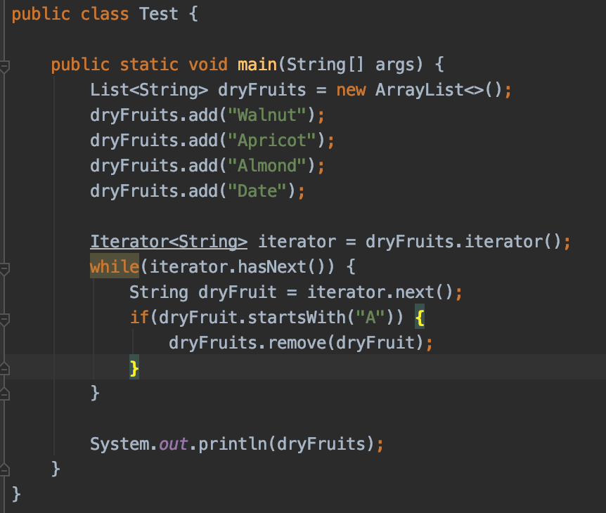
Q3. Having next code bellow what will be the result ?
a) [Walnut, Apricot, Almond, Date]
b) Compilation error
c) An exception is thrown runtime
d) [Walnut, Date]
c) An excretion dyring runtime - ConcurrentModificationException

Slide 5
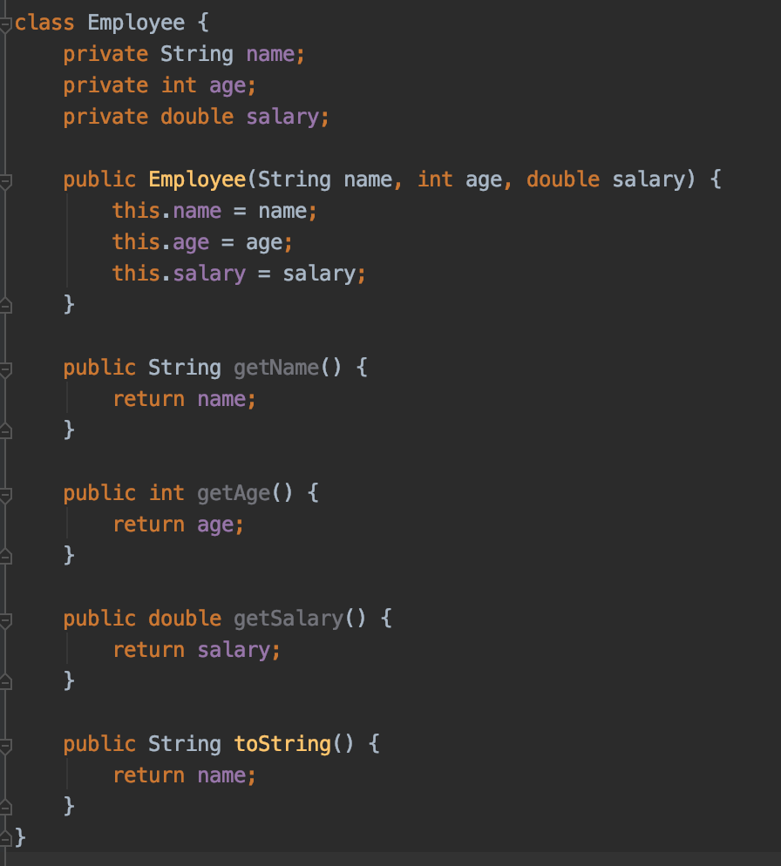
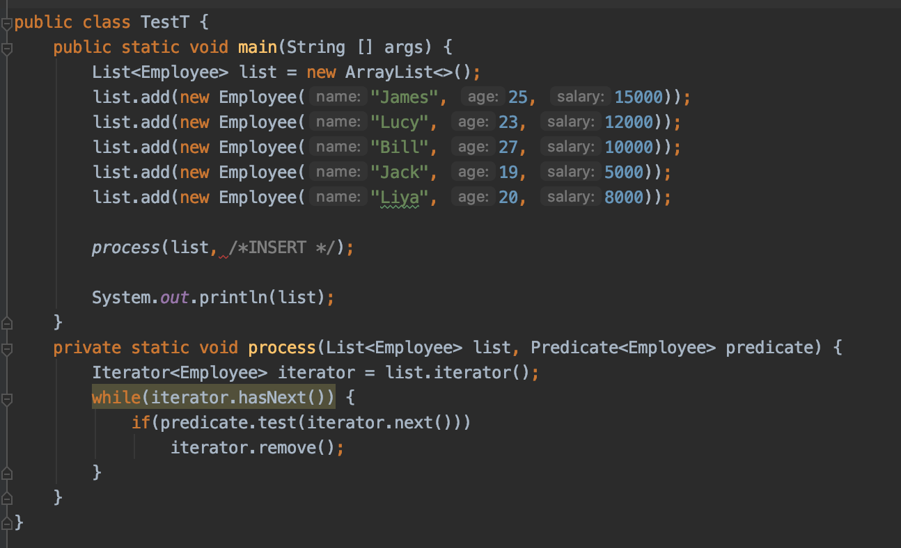
Q4. Which of the following lambda expressions, if used to replace /*INSERT*/, prints [Jack, Liya] on to the console? Select ALL that apply.
e -> { e.getSalary() >= 10000}
(e) -> { e.getSalary() >= 10000 }
e -> e.getSalary() >= 10000
d) e - > e.getSalary() >= 10000
e) (Employee e) -> {return e.getSalary() >= 10000; }
c) and e)
Jack's salary is 5000 and Liya's salary is 8000. If Employee's salary is >= 10000 then that Employee object is removed from the list

Slide 6
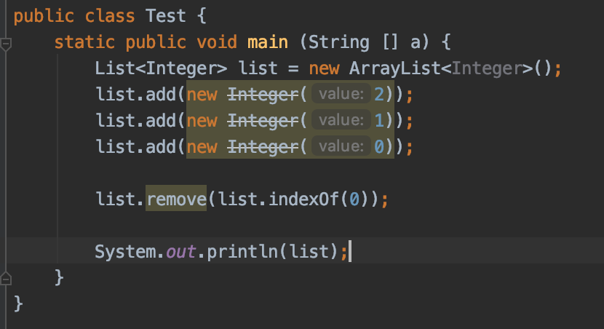
Q5. What will be the result of compiling and executing the Test class?
[1, 0]
An Exception throws at runtime
[2, 1]
Compilation error
C)

Slide 7
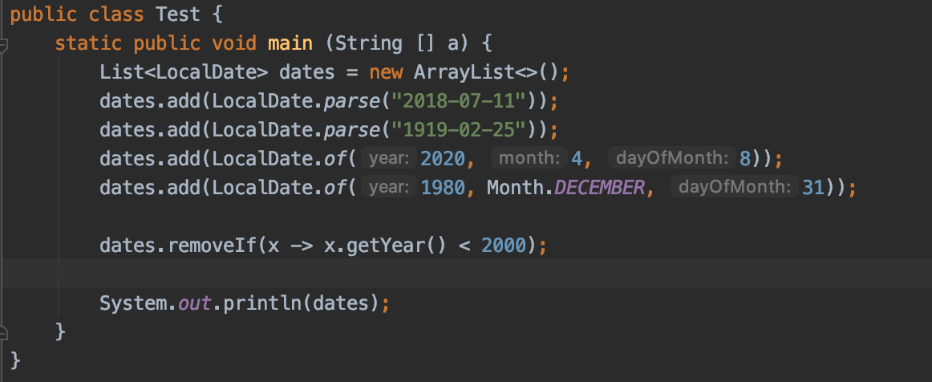
Q6. What will be the result of compiling and executing Test class?
Runtime exception
[2018-07-11, 2020-04-08]
[2018-07-11, 2020-04-08, 1980-12-31]
[1919-02-25, 1980-12-31]
b) [2018-07-11, 2020-04-08]

Slide 8
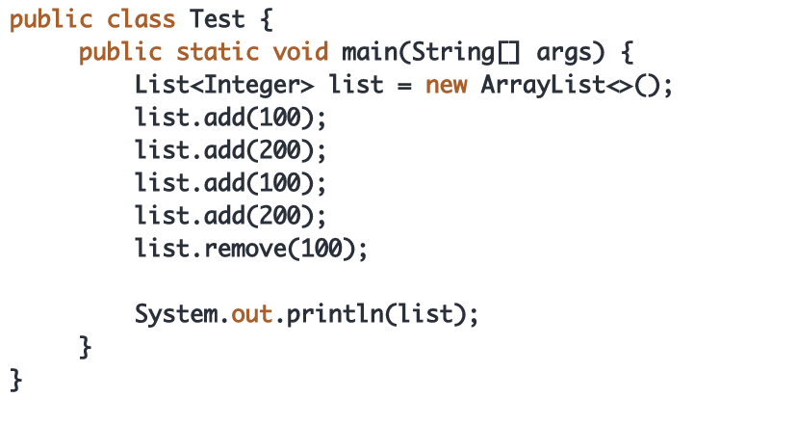
Q7. What will be the result of compilation and executing the code ?
Compilation error
[200, 100, 200]
Exception is throws at runtime
[200, 200]
[200]
[100, 200, 200]
C) runtime exception as the method recognise by index as it is int not Integer

Slide 9
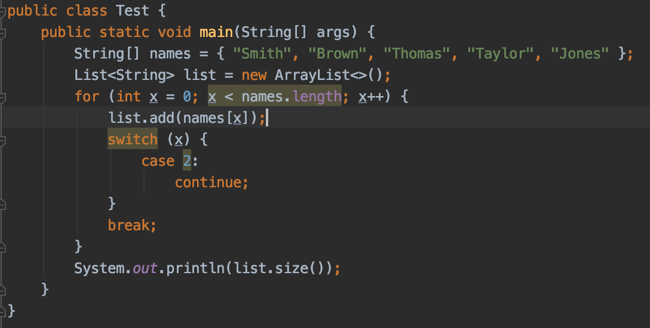
Q8. What will be the result of compilating and executing the code ?
a) 2
b) 5
c) Non of the other options
d) 3
e) 1
f) 4
g) 0
E)

Slide 10
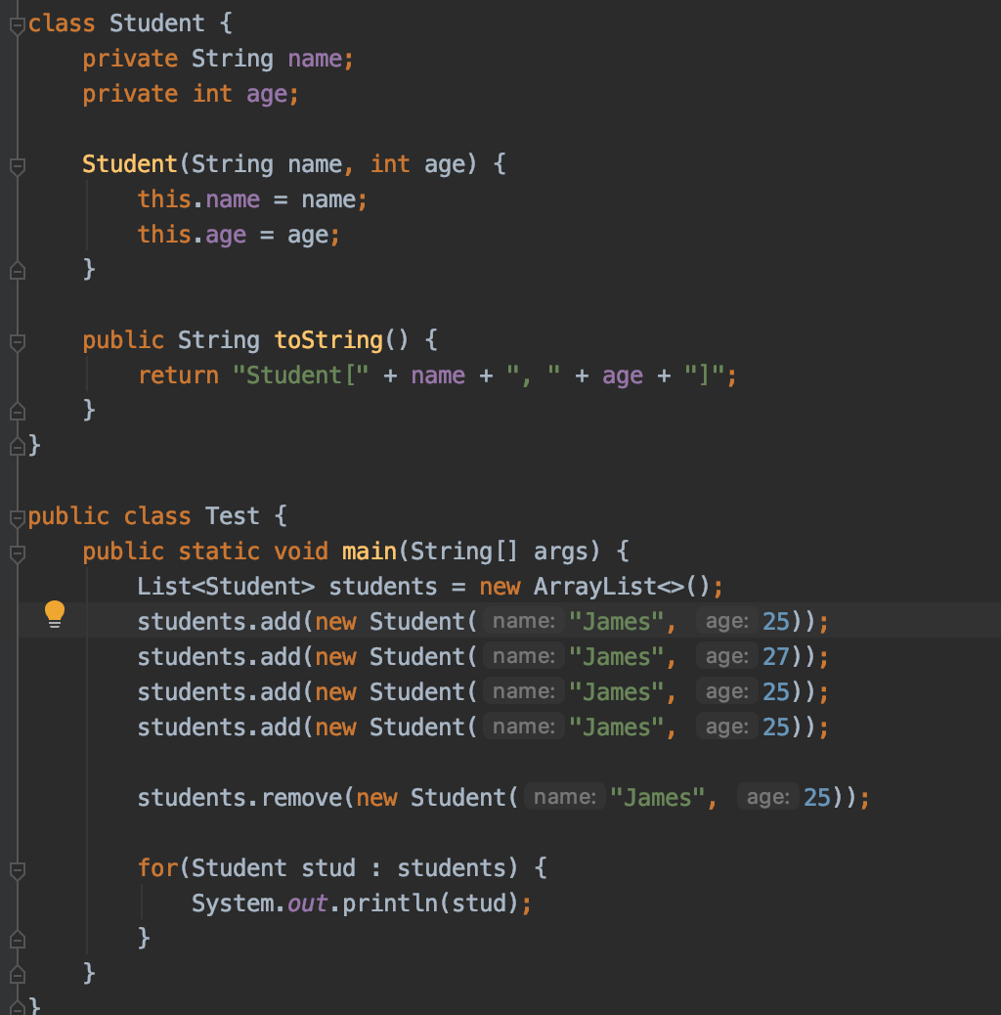
Q9. What will be the result of executing of Test class ?
a) Student[James, 25]
Student[James, 27]
Student[James, 25]
Student[James, 25]
b) Student[James, 27]
c) Student[James, 27]
Student[James, 25]
Student[James, 25]
d) Student[James, 25]
Student[James, 27]
Student[James, 25]
A)

Slide 11
Q10
For the given code snippet:
List<String> list = new /*INSERT*/();
Which of the following options, if used to replace /*INSERT*/, compiles successfully? Select ALL that apply.
​
a) ArrayList<String>
b) List<>
c) List<String>
d) ArrayList<>
a) and d)

Slide 12
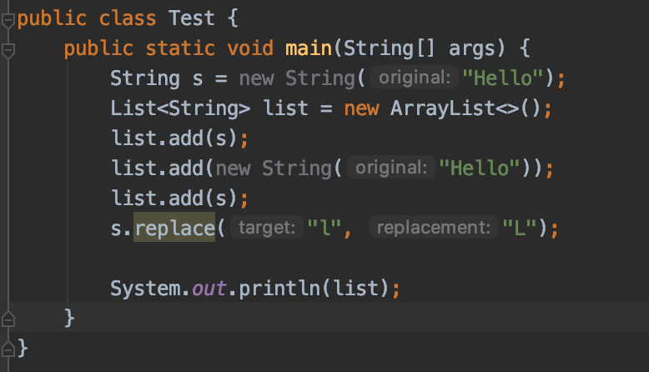
Q11. What will be the result of compiling and executing of test class ?
[HeLLo, Hello, Hello]
[HeLLo, Hello, HeLLo]
[Hello, Hello, Hello]
[HeLLo, HeLLo, HeLLo]
c)

Slide 13
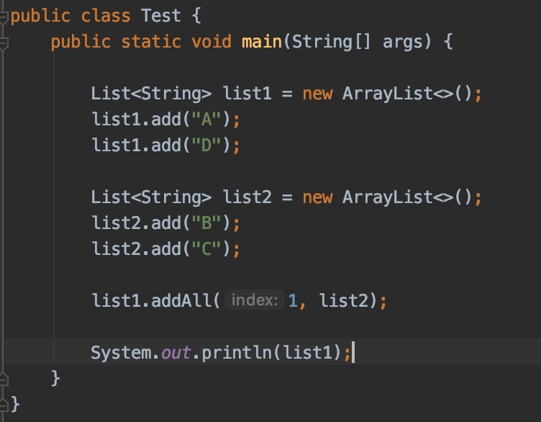
Q12. What will be the result of compiling and executing the Test class ?
[A, D]
[A, B, C, D]
[A, D, B, C]
[A, B, C]
B

Slide 14
Q13. Which of the following compiles the code when replacing 2?
a) int length = l.capacity;
b) int length = l.capacity();
c) int length = l.length;
d) int length = l.length();
e) int length = l.size;
f) int length = l.size();
g) None of the above.
1) ArrayList l = new ArrayList();
2)// INSERT CODE HERE

Slide 15
Q14. Which of the following is true (Choose all apply)
a) An array has a fixed size.
b) An ArrayList has a fixed size.
c) An array allows multiple dimensions.
d) An array is ordered.
e) An ArrayList is ordered.
f) An array is immutable.
g) An ArrayList is immutable.
a), d), e), f)

Slide 16
Q15 What is the result of compiling and executing the next code?
A) onetwo
B) onetwo7
C) onetwo followed by an exception
D) Compiler error on line 3.
E) Compiler error on line 4.
List<String> list = new ArrayList<String>();
1) list.add("one"); 2) list.add("two"); 3) list.add(7); 4) for(String s : list) System.out.print(s);
d)

Slide 17
Thank You For Your Time

